Slide 1
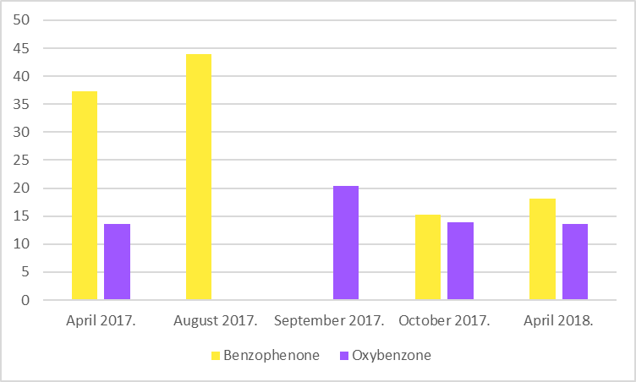
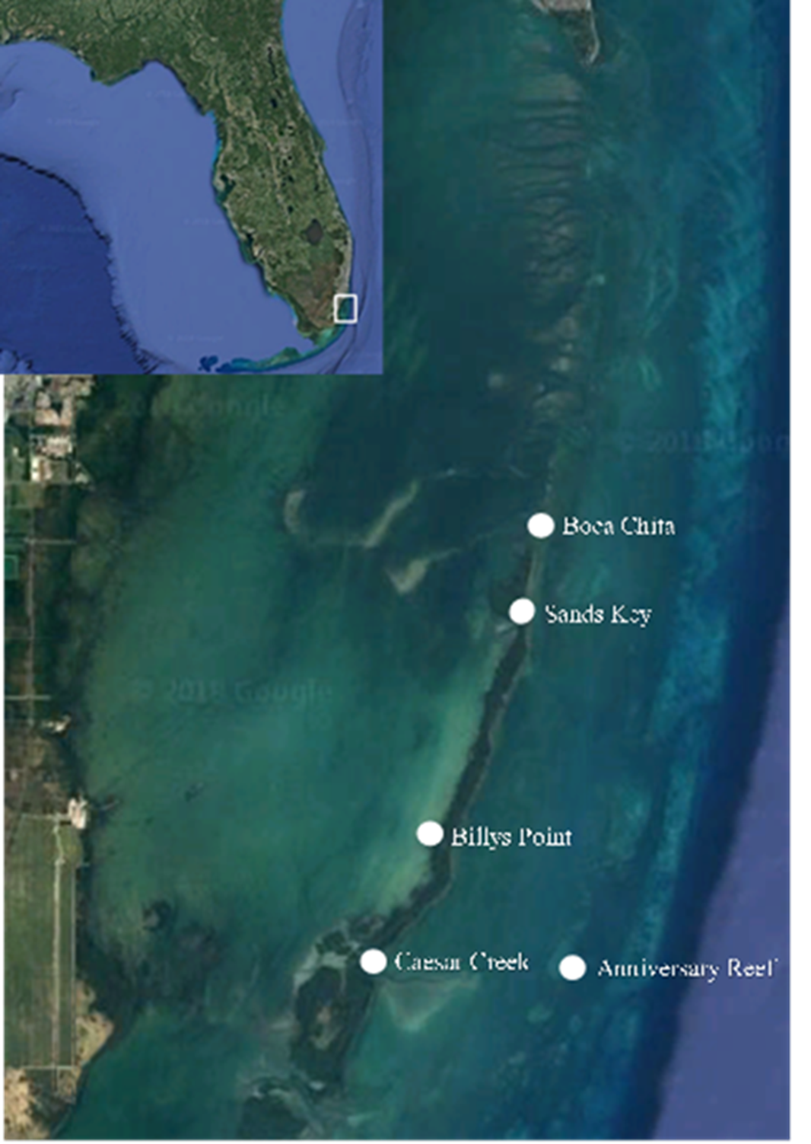
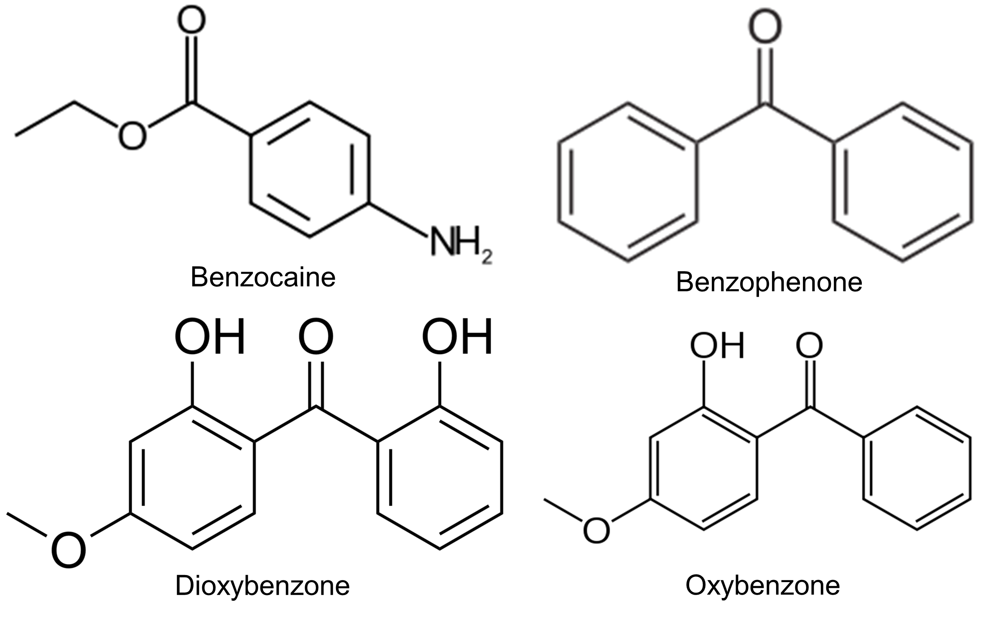
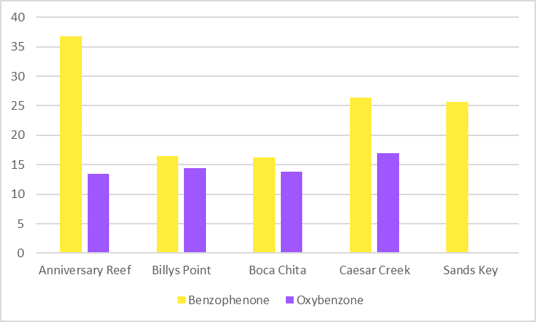
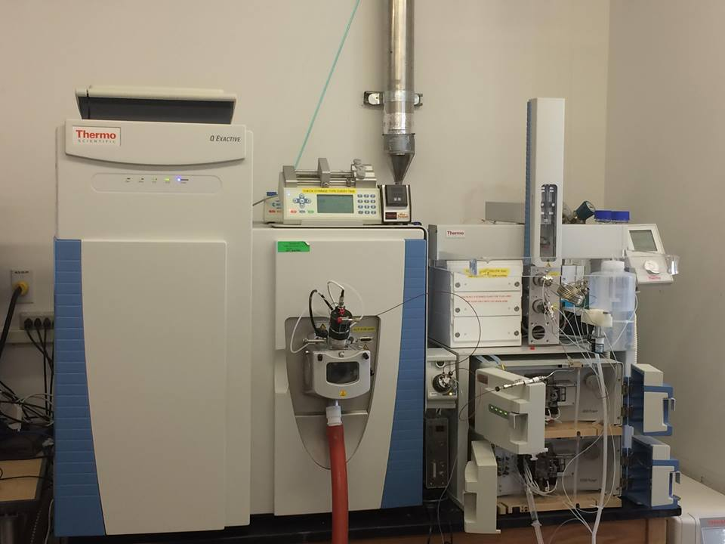
The occurrence and prevalence of UV filter chemicals in surface water samples in Biscayne Bay and Biscayne National Park
Steven Landeweer^{1,2}, Cody Henderson^{1,2} Brian Ng¹, Natalia Quinete^{1,3}, and Piero Gardinali^{1,2,3}
¹Department of Chemistry and Biochemistry, Florida International University, 11200 SW 8th Street, Miami, Florida 33199
²CREST Center for Aquatic Chemistry and Environment, Biscayne Bay Campus, 3000 Northeast 151st Street, Miami, FL 33181
³ Southeast Environmental Research Center, OE-148, Florida International University, 11200 SW 8th Street, Miami, Florida 33199
BACKGROUND
RESULTS
UV filters are a large and heterogeneous group of chemicals that are ingredients in personal care products to protect skin and hair from the sunlight, and in other industrial goods such as paint, wax, plastic, or textile to prevent photodegradation of polymers and pigments¹. Currently, there are some research gaps regarding the occurrence, fate, and effects of these emerging contaminants on the ecosystems. Chemical UV filters, the active ingredients in most common sunscreens, have been shown to cause damage to both coral reefs² and juvenile coral (planulae)³. This has led to concerns about the safety of coral reefs in areas with large amounts of marine recreational activities. In response to these concerns, Hawaii has banned all non-prescription sunscreens containing oxybenzone. Biscayne National Park, located on the border of the Miami metropolitan area, is home to a large coral reef system and is a popular recreational area for both tourists and locals, leading to concern that the reefs there could be negatively affected by UV filters.
Method detection limits (MDLs) in DI water ranged from 4 to 6, while in artificial saltwater were 18 to 21
Benzophenone was detected in 49% of the samples at concentrations up to 131 ng/L.
Oxybenzone was detected in 29% of the samples at concentrations up to 31 ng/L.
Benzocaine and dioxybenzone were not detected above the MDL in the collected BNP samples.
Average Concentration (ng/L)
Compound | Formula | Monoisotopic Mass | Ion Mass (m/z) | Quantitative Ion Fragment (m/z) | Confirming Ion Fragment (m/z)
Benzocaine | C₉H₁₁NO₂ | 165.0789 | 166.0863 | 138.0511 | 120.0412
Benzophenone D-10 (internal standard) | C₁₃D₁₀O | 192.1359 | 193.1432 | 193.1432 | -
Oxybenzone D-5 (internal standard) | C₁₄H₇D₅O₃ | 233.1100 | 234.1173 | 151.0347 | -
Oxybenzone | C₁₄H₁₂O₃ | 228.0786 | 229.0860 | 151.0347 | 105.0309
Dioxybenzone | C₁₄H₁₂O₄ | 244.0735 | 245.0808 | 121.0253 | 151.0348
Benzophenone | C₁₃H₁₀O | 182.0731 | 183.0795 | 105.0307 | 183.0754
GOALS
Figure 5. Seasonal distribution of benzophenone and oxybenzone at BNP sites.
Development of a method based on online solid phase extraction liquid chromatography-high resolution mass spectrometry (online SPE LC-HRMS) for the determination of UV filters in seawater.
Assessment of the presence of UV filters in the Biscayne National Park (BNP) and the potential risks to coral reefs.
Evaluation of seasonal and spatial variations of UV filters at BNP.
CONCLUSIONS and FUTURE WORK
Table 1- Detailed compound list with their respective formula, monoisotopic mass, and monitored species.
An Online SPE LC-HRMS was successfully developed and validated for the determination of UV filters in seawater samples.
The inclusion of an qualitative ion in the analysis by parallel reaction monitoring (PRM) confers the method better selectivity in the identification of UV filter components, such as benzophenone.
Benzophenone and oxybenzone were the only UV filter compounds found to be prevalent in Biscayne National Park.
Levels found were low (<150 ppt) below the levels known to cause coral damage or other associated health impacts in the ecosystem.
There was little spatial variation, but significantly higher levels of benzophenone were observed in April and August 2017 in relation to September and October 2017, which could be associated with spring break and summer vacations.
Further studies will focus on the sunscreen levels and distribution in surface waters from Biscayne National Park during events of high and low visitor use to better understanding the impact of the increasing use of UV filters in the aquatic ecosystem.
Samples will also be taken of the surface slick of the water and from submerged surfaces mimicking coral.
Laboratory experiments will be conducted to determine the total amount and rate at which sunscreen UV filters wash off a surface and into the water
Future research also include the studies on the photodegradation of UV filters to evaluate potential transformation products and their presence in surface waters.
METHODS
Compound | Precision (%) | MDLs (ng/L) in DIW | MDLs (ng/L) in saltwater | Recovery (%)
Benzocaine | 3 | 4 | 20 | 92
Oxybenzone | 7 | 6 | 20 | 87
Dioxybenzone | 3 | 4 | 18 | 84
Benzophenone | 11 | 5 | 21 | 90
Thirty-five (n=35) seawater samples were collected from five sites in Biscayne National Park (Fig. 1)
Samples were analyzed for the presence of commonly used UV filters (Fig. 2) by online SPE HPLC-HRMS
Table 2- MDLs, recoveries and precision of the developed online SPE LC-HRMS method
Average Concentration (ng/L)
REFERENCES
Figure 1. Map of Sample Sites at Biscayne National Park.
Figure 2. Structures of the target compounds
Zenker, A.; Schmutz, H.; Fent, K. Simultaneous trace determination of nine organic UV-absorbing compounds (Uv filters) in environmental samples. J. Chromatogr. 2008, 1202, 64-74.
Danovaro, R.; Bongiorni, L.; Corinaldesi, C.; Giovannelli, D.; Damiani, E.; Astolfi, P.; Greci, L.; Pusceddu, A. Environmental Health Perspectives 2008, 116 (4), 441–447.
Downs, C. A.; Kramarsky-Winter, E.; Segal, R.; Fauth, J.; Knutson, S.; Bronstein, O.; Ciner, F. R.; Jeger, R.; Lichtenfeld, Y.; Woodley, C. M.; Pennington, P.; Cadenas, K.; Kushmaro, A.; Loya, Y. Archives of Environmental Contamination and Toxicology 2015, 70 (2), 265–288.
Mass Spec Parameters
Atmospheric Pressure Chemical Ionization (APCI) Source
Resolution of 17500
Positive mode
10 mL injection volume
PRM scan
Mass tolerance <5ppm
ACKNOWLEDGEMENTS
Figure 4. Spatial distribution of benzophenone and oxybenzone at BNP.
Steven Landeweer was supported by the National Science Foundation under Grant No. HRD-1547798. This NSF Grant was awarded to Florida International University as part of the Centers of Research Excellence in Science and Technology (CREST) Program.
Any opinions, findings, and conclusions or recommendations expressed in this material are those of the author(s) and do not necessarily reflect the views of the National Science Foundation.
The authors would like to thank Vanessa McDonough from the National Park Service for providing the samples for this work and Thermo Scientific for providing partial analytical support
Figure 3.Thermo Q-Exactive Orbitrap

