Slide 1
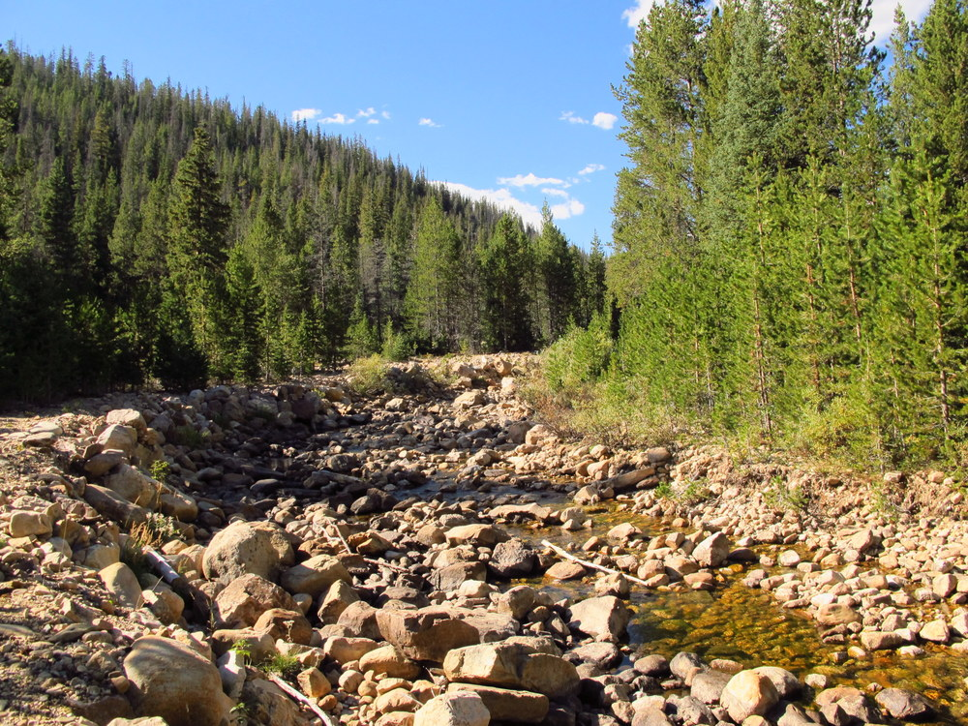
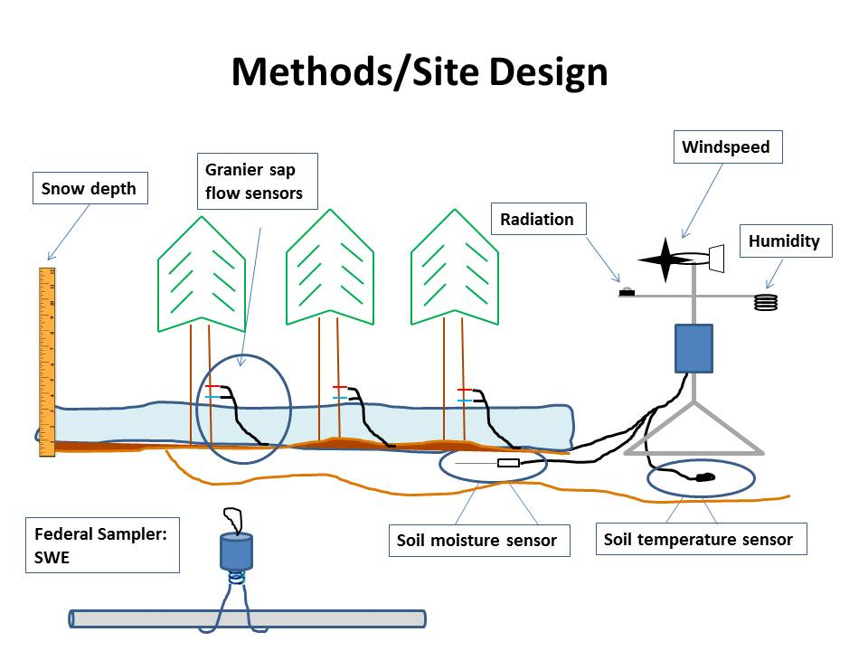
CREST CAChE Student Poster Template
Name, Florida International University
Research Mentor:
Goals
Research Methodology
Results
Determine the role of Inhibitor of Differentiation 3 (ID3) transcription regulator protein involvement in environmental pollutant exposure response.
Other
Install sap flow sensors at three sites along an elevation gradient to measure transpiration
Measure snow depth and SWE at multiple locations at each site throughout the winter and snowmelt period using a Federal sampler
Montane forest snowmelt is the primary source of water for the Wasatch Region
If we can identify the environmental variables that influence annual variations in water availability we can better predict future water resources
sites
Figure 1. North Fork of the Provo River in the Uinta Mountains.
Figure 3. Transpiration is predicted to be limited by cold temperatures at high elevations and water availability at low elevations.
Figure 2. Sap flux instrumentation and climate station locations
This material is based upon work supported by the National Science Foundation under Grant No. HRD-1547798. This NSF Grant was awarded to Florida International University as part of the Centers of Research Excellence in Science and Technology (CREST) Program. Any opinions, findings, and conclusions or recommendations expressed in this material are those of the author(s) and do not necessarily reflect the views of the National Science Foundation.
Jane.doe@fiu.edu
http://crestcache.fiu.edu

