Slide 1
Investigating the Environmental Fate and Transport of Sunscreen Components: Understanding the Exposure Route
Steven Landeweer¹ , Natalia Soares-Quinete² , Piero Gardinali^{1,2}
¹Department Of Chemistry And Biochemistry, Florida International University, 11200 SW 8th Street, Modesto A. Maidique Campus, Miami, Florida, 33199 United States.
²Southeast Environmental Research Center (SERC), Florida International University, 3000 Ne 151st St, Biscayne Bay Campus, North Miami, Florida, 33181, United States.

Slide 2
Why We’re Here
UV filters, especially oxybenzone, have been linked to adverse effects in coral
Many jurisdictions have considered or passed bans on certain sunscreen formulations
However, much is still unknown

Slide 3
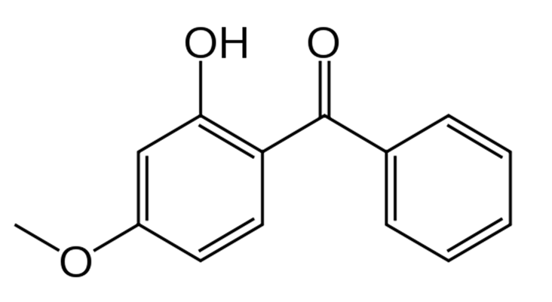
My Question
How does oxybenzone actually behave in the water column?
Log K_{ow} = 3.79 (EpiSuite)
Two interfaces to worry about- oil/water and water/air

Slide 4
Goals
To determine the concentration of oxybenzone in aqueous solution in equilibrium with a commercial sunscreen formulation
To determine the time it takes to reach that equilibrium
Are these values effected by salinity?
To create a truly dissolved solution of UV filters in water

Slide 5
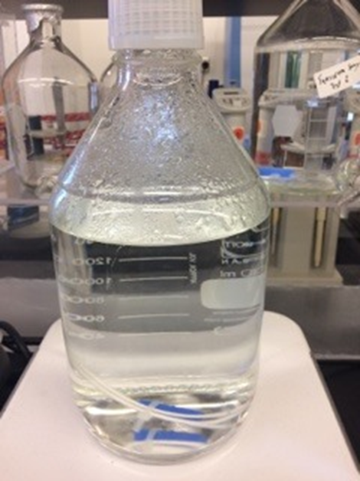
Methodology
Silicone Passive Diffusion Releasers (SPDRs)
Permeable PDMS membranes
1 gram of sunscreen in three SPDRs added to a jar with 2 liters of either DI Water or artificial seawater
Stirred at 60 rpm (without forming a vortex)
Samples analyzed by LC-MS

Slide 6
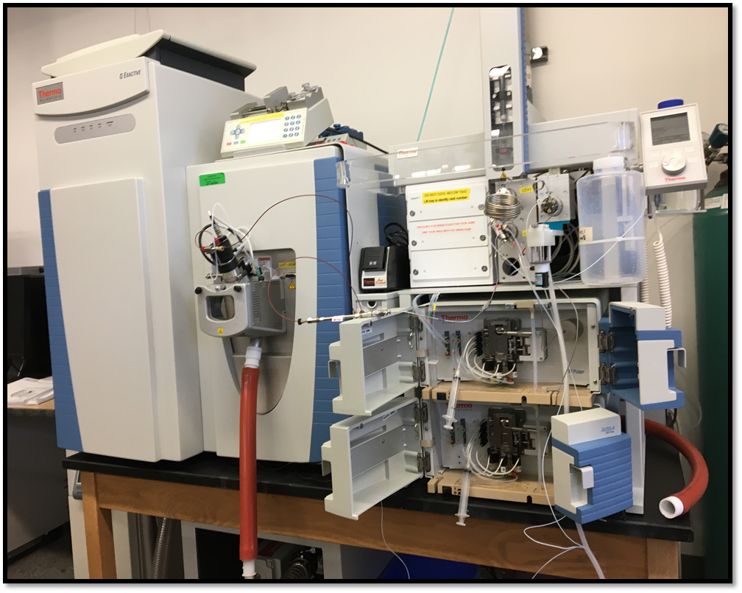
LCMS
Thermo Q-Exactive Orbitrap
10 μL injection volume
Heated electrospray ionization (HESI) source
Positive Mode
Parallel Reaction Monitoring (PRM) method

Slide 7
Modeling
PAHs were previously found to behave according to the equations
C_{t} = C_{eq} x (1 - e^{-kt})
t_{eq} = 3/k
C_{eq} = equilibrium concentration
t_{eq} = time until equilibrium
Loreta Alvarez-Fraga, Cesar E. Ramirez, Natalia Quinete, Sudha Rani Batchu, Kathia Sandoval and Piero R. Gardinai Unpublished Data

Slide 8
Results: Deionized Water
C_{t}=0.901(1-e^{-0.320t})
C_{eq} = 0.901 ppm
t_{eq} = 9.8 hr

Slide 9
Results: Artificial Seawater
C_{t}=1.78(1-e^{-0.876t})
C_{eq} = 1.78 ppm
t_{eq} = 3.4 hr

Slide 10
Results Comparison
 | DI Water | Artificial Seawater
Oxybenzone Added | 60 mg | 60 mg
Equilibrium Concentration | 0.901 ppm | 1.78 ppm
Oxybenzone in Solution | 1.80 mg | 3.56 mg
Percentage of Oxybenzone in Solution | 3.00% | 5.93%
Predicted Solubility, EpiSuite: 68.6 ppm

Slide 11
Matrix Effects?
Ran 5 100 ppm replicates in DI water and artificial seawater
Performed a t test
P value = 0.341
No significant difference

Slide 12
Environmental Levels
Environmental samples from Biscayne Bay analyzed by LCMS method
Oxybenzone detected up to 31 ppt in Biscayne National Park, and up to 53 ppt in northern Biscayne Bay
Much lower than concentrations achieved from SPDR experiments

Slide 13
Conclusions/summary
A truly dissolved solution of oxybenzone was created by use of SPDRs
The concentration over time of oxybenzone in solution was accurately modeled
Equilibrium between sunscreen formulation and aqueous solution was reached in 9.8 hr for DI water and 3.4 hr for artificial seawater
Concentrations at equilibrium were 0.901 ppm in DI water and 1.78 ppm in artificial seawater

Slide 14
Lingering Questions/Future Work
Why is equilibrium concentration of oxybenzone higher in ASW than DI water?
Property of the PDMS?
Interactions with inactive ingredients?
Create models for all common sunscreen ingredients

Slide 15
Acknowledgements
Research Advisor:
Dr. Piero Gardinali
Group members:
Dr. Natalia Quiente
Autumn Henderson
Brian Ng
Kassidy Troxell
Kyle Meerbott
This material is based upon work supported by the National Science Foundation under Grant No. HRD-1547798. This NSF Grant was awarded to Florida International University as part of the Centers of Research Excellence in Science and Technology (CREST) Program. Any opinions, findings, and conclusions or recommendations expressed in this material are those of the author(s) and do not necessarily reflect the views of the National Science Foundation.

