Slide 1
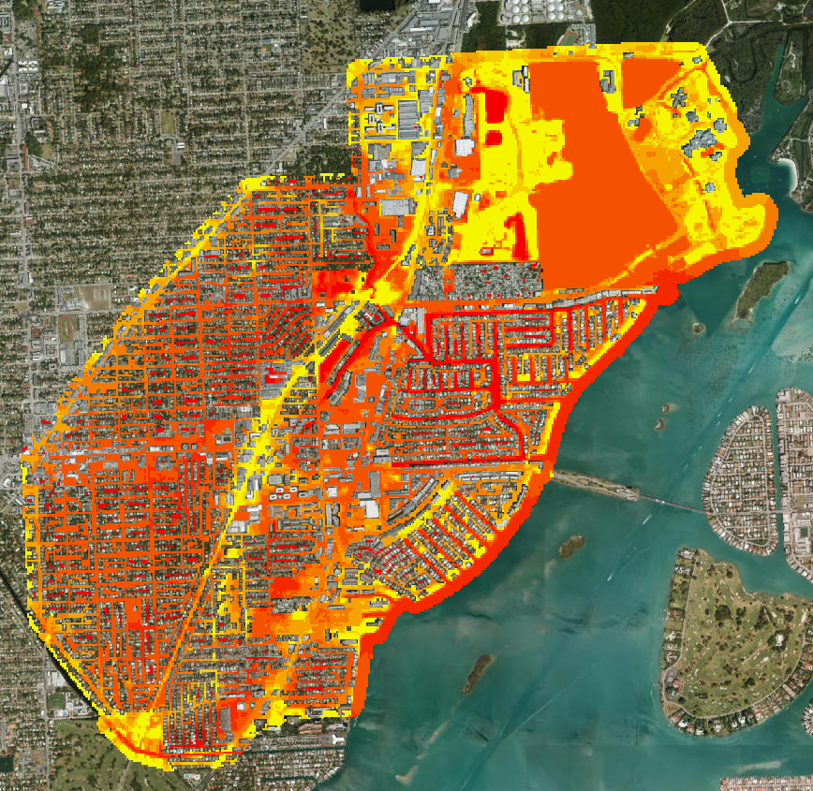
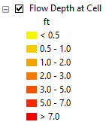
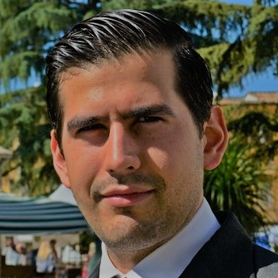
Building flood resilience through integrated 2D flood modeling:
The case study of Arch Creek Basin
Francisco Peña^{*1234}, Jayantha Obeysekera⁴, Fernando Nardi¹⁵, Fabio Castelli²⁵, Assefa Melesse³
¹WARREDOC, University for Foreigners of Perugia – ²DICEA, University of Florence – ³Department of Earth & Environment, Florida International University –
⁴Sea Level Solutions Center (SLSC), Florida International University – ⁵UNESCO Chair on Sustainable Water Security, Institute of Water and Environment (InWE), FIU
Introduction
Methodology
Preliminary Results
BACKGROUND:
The Arch Creek Basin is characterized by low-lying topography and historic housing infrastructure, which over 80% were built pior to enforcing flood criteria (ULI, 2017).
Flood risk is exacerbated by a rising water table caused by rain, tides, and sea level rise (Sukop et al., 2017). Conditions are expected to worsen due to climate change (SLSC, 2019).
Miami-Dade County has recently experienced a paradigm shift on how to approach climate change and build more flood resilient communities with short-term adaptation and long-term mitigation strategies.
PROPOSED RESEARCH:
Development of a holistic 2D hydraulic model able to simulate the complex interactions of fluvial, pluvial, and coastal flooding conditions: surface runoff, storm drain systems, coastal surge, and groundwater flow.
Evaluate the potential of coarser resolution models in urban settings to identify the maximum grid resolution thresholds (i.e. 10ft, 25ft, 50ft) for model optimization.
The 2D dynamic flood routing model for open channel hydraulics and unconfined overland flow FLO-2D (O’Brien, 1993) is coupled with:
1D Pipe hydraulics: EPA SWMM (Rossman, 2009)
3D Groundwater conditions: MODFLOW-2005 (Harbaugh, 2005)
This research investigates the development of a coupled 2D hydraulic model that captures the complete picture of flooding due to rainfall, storm surge, and sea level rise using a 50ft grid resolution.
The integration of all flooding conditions is a challenge but can provide unique insights on the hydraulics behavior compared to a single modeling approach.
Conclusions and Opportunities
Components
Promising results for adopting coarser models improves computational efficiency. Performance metrics are still needed to evaluate the water surface levels and flood inundation extent.
Further validation with official hydrologic and hydraulic modeling tools by the SFWMD (XP-SWMM).
This research can set the foundation to investigate the ripple effects of flooding in multidisciplinary fields (i.e. socio-economic costs, performance of structural measures, flooded septic tanks, urban and ecological degradation).
Citizen science measurements and initiatives can contribute to flood models calibration parameters and reduce errors in flood delineation.
Channels*
Storm drainage system*
Buildings and Land Use
Infiltration
Coastal Surge
References
Urban Land Institute (2016).Arch Creek Basin Miami-Dade County, Florida. Addressing Climate Vulnerabilities and Social Equity with an Adaptation Action Area Framework. May 22-27, 2016.
Sukop, Michael & Rogers, Martina & Guannel, Greg & Infanti, Johnna & Hagemann, Katherine. (2017). High temporal resolution modeling of the impact of rain, tides, and sea level rise on water table flooding in the Arch Creek basin, Miami-Dade County Florida USA. Science of The Total Environment. 616-617. 10.1016/j.scitotenv.2017.10.170.
Sea Level Solutions Center (SLSC), Florida International University (FIU) (2019), Potential Implications of Sea-Level Rise and Changing Rainfall for Communities in Florida using Miami-Dade County as a Case Study
Figure 1: Flooding levels Arch Creek Basin
This material is based upon work supported by the National Science Foundation under Grant No. HRD-1547798. This NSF Grant was awarded to Florida International University as part of the Centers of Research Excellence in Science and Technology (CREST) Program. Any opinions, findings, and conclusions or recommendations expressed in this material are those of the author(s) and do not necessarily reflect the views of the National Science Foundation.
fpena023@fiu.edu
http://warredoc.unistrapg.it
http://crestcache.fiu.edu

