Slide 1





Hybridizing Florida’s Coastline with Mangrove Ecological Infrastructure by Marbelys Garriga

Slide 2
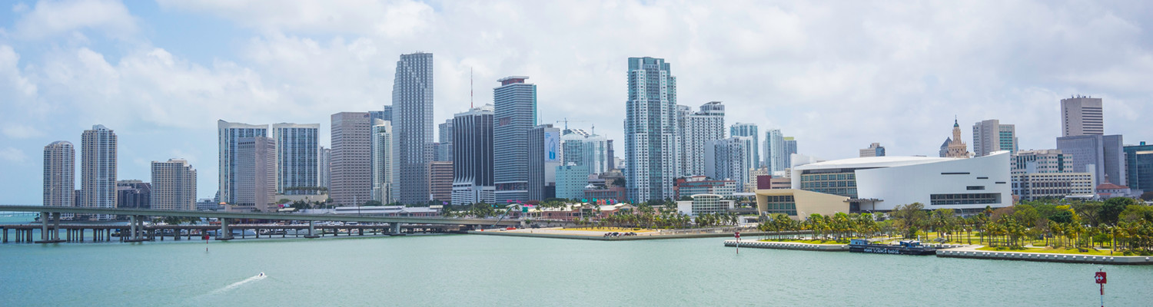
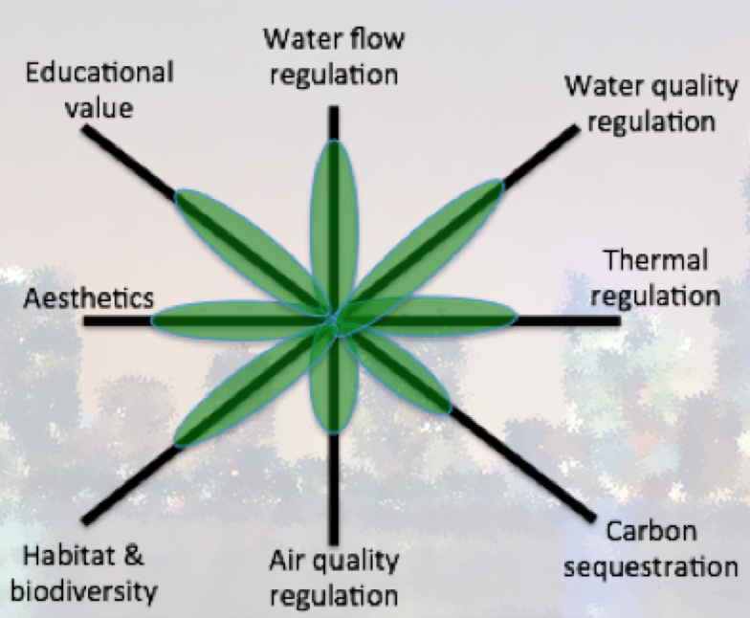
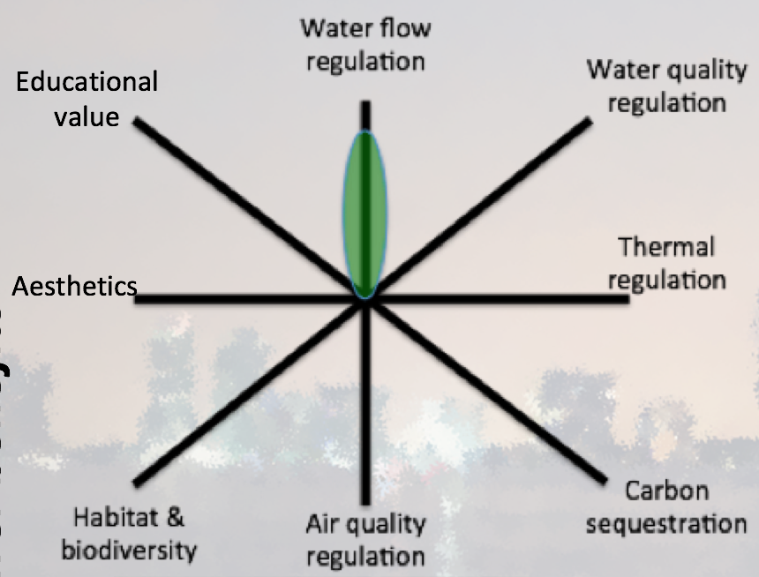
Green Vs Gray

Slide 3
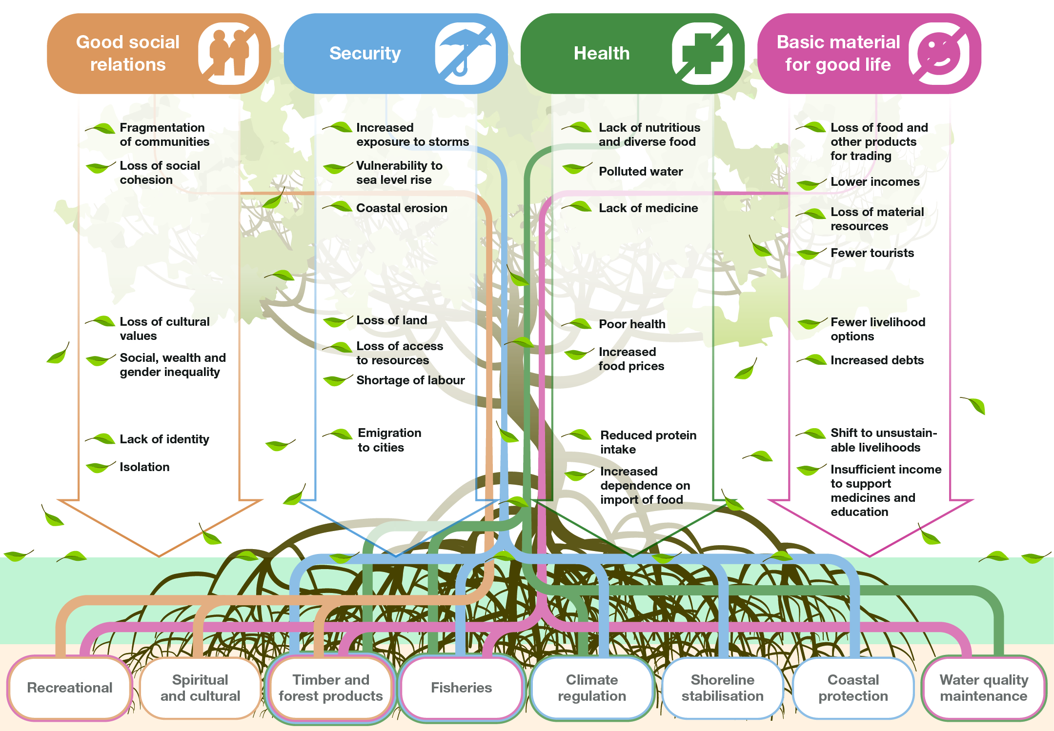

The loss of these roots impacts the leaves!

Slide 4
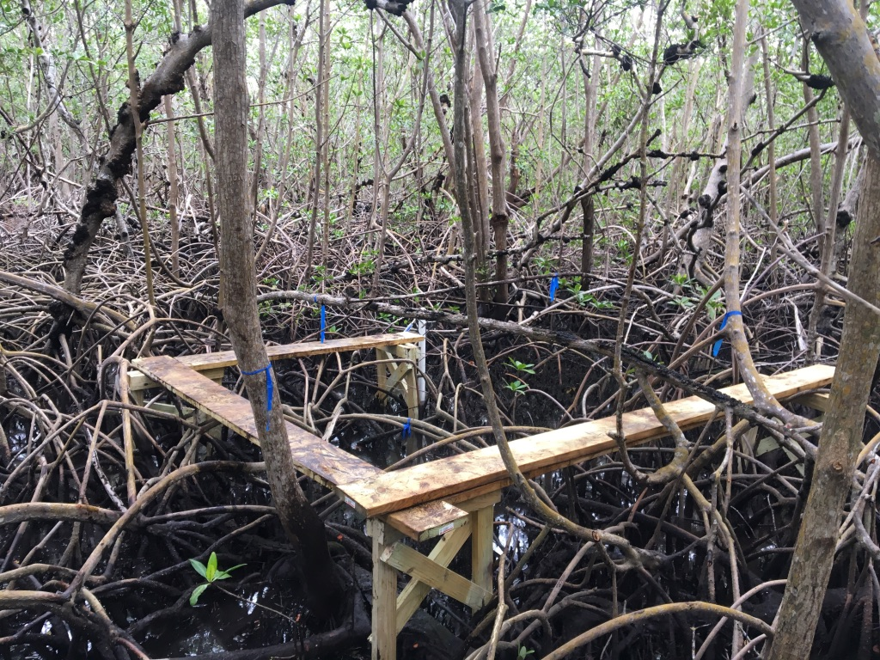
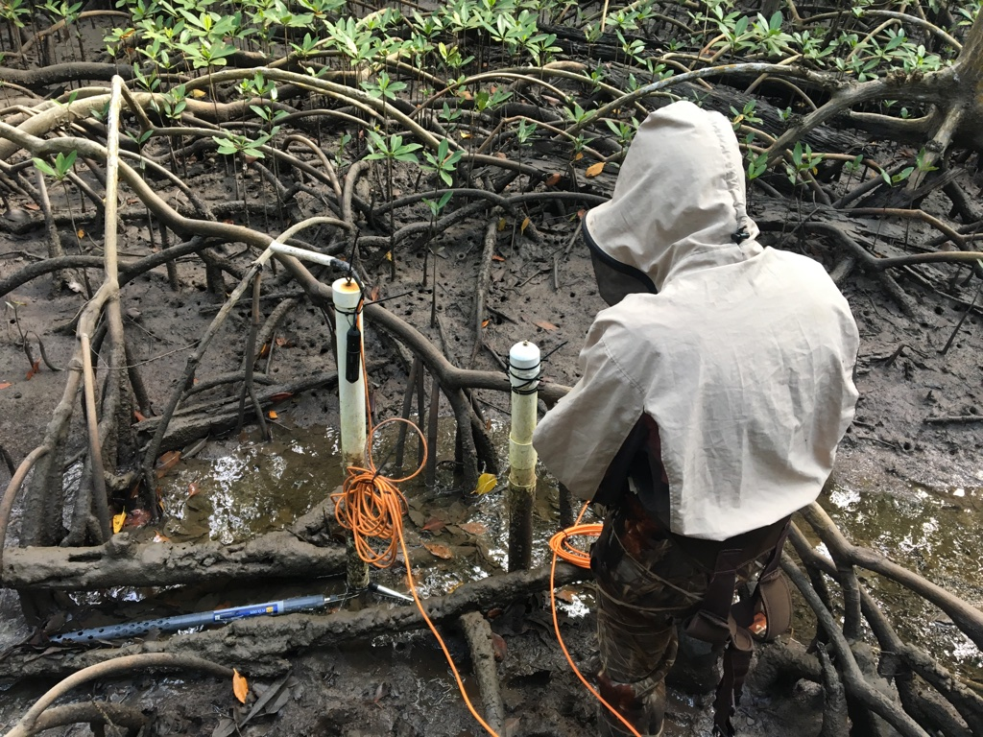
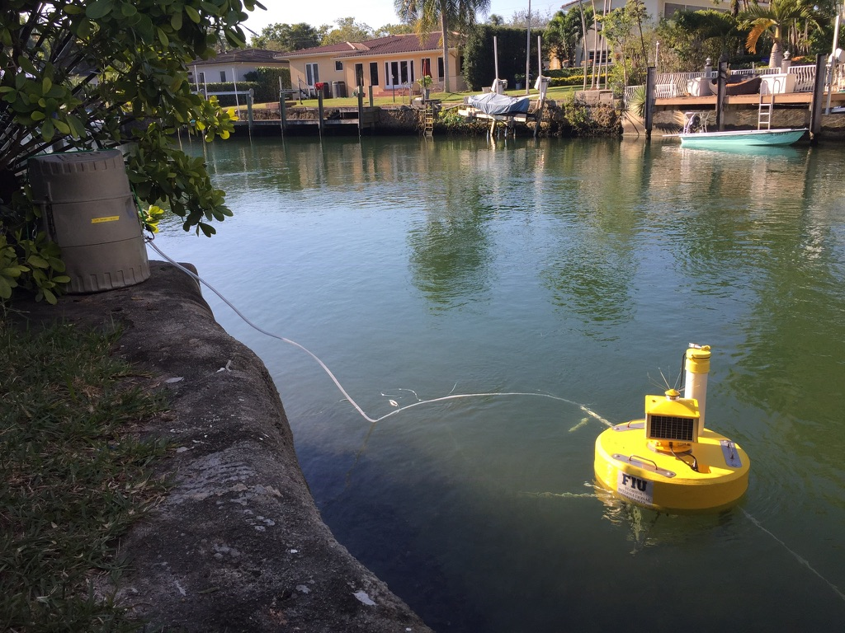
Ecological Infrastructure Solutions for Cities
Accretion
Carbon Fluxes
Hands-off Water Quality Monitoring
Active Monitoring in the City of Coral Gables

Slide 5
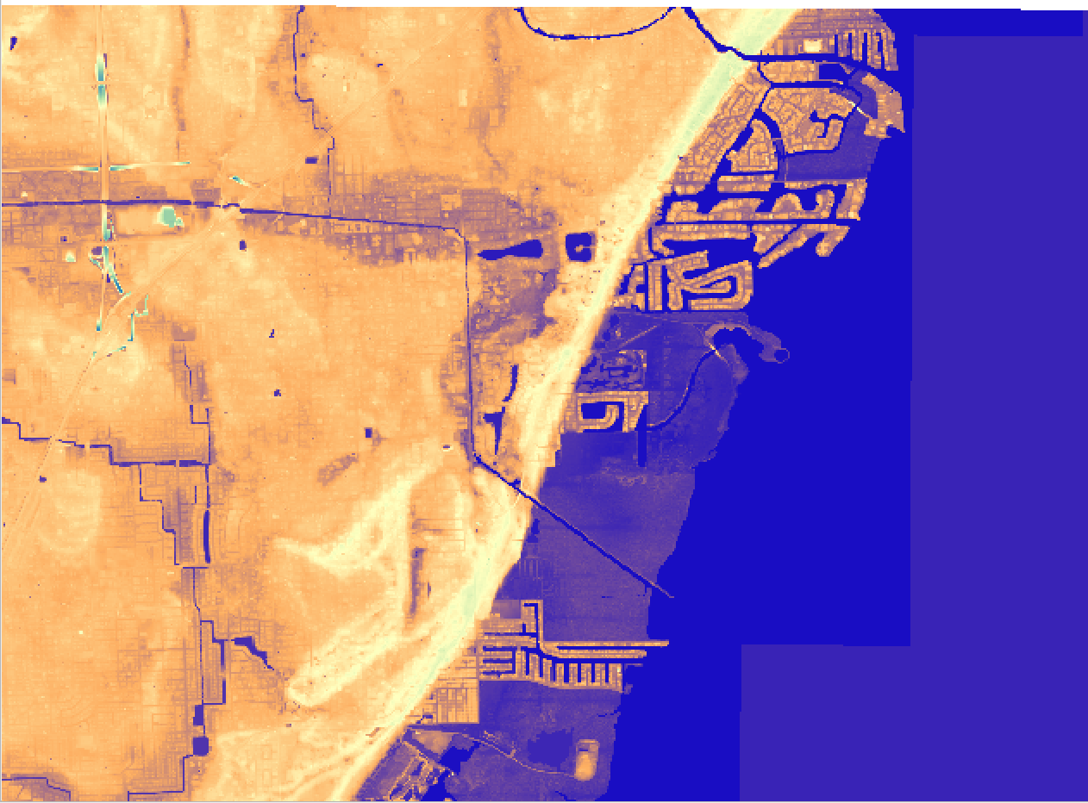
Project Proposal

Slide 6
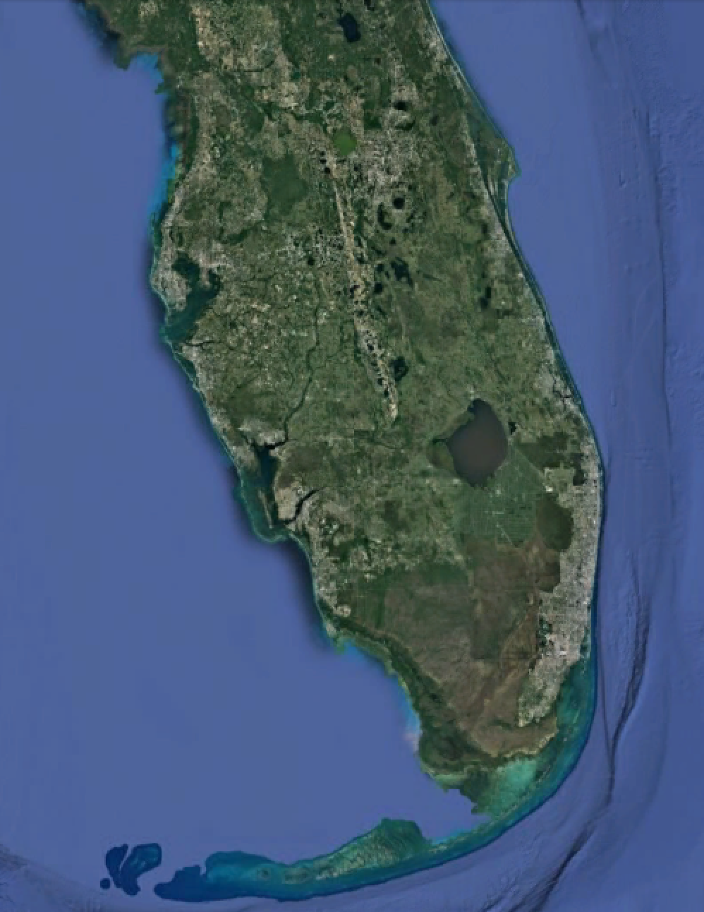
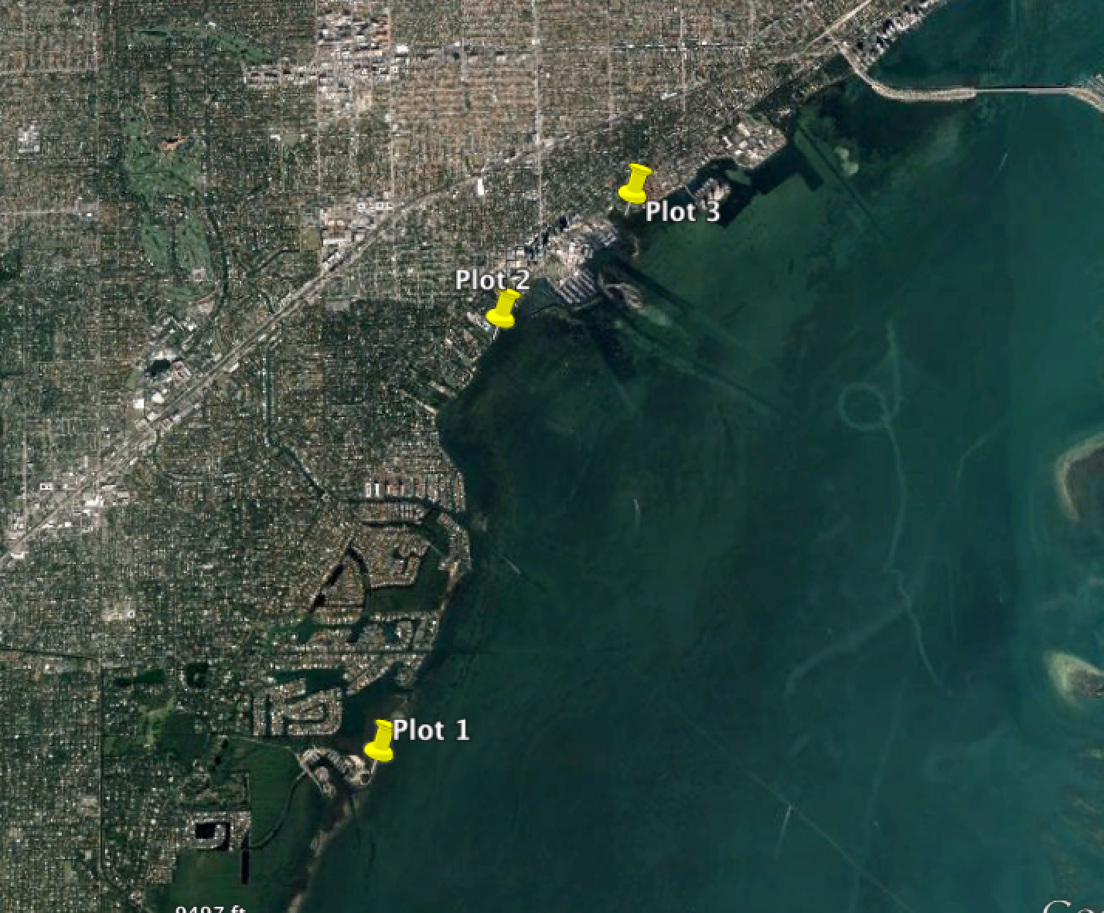
Proposed Sites

Slide 7

Expected Outcomes
Significant improvement in water quality
Increase in urban resilience
Boost in local fauna
Decrease in seawall maintenance costs

Slide 8
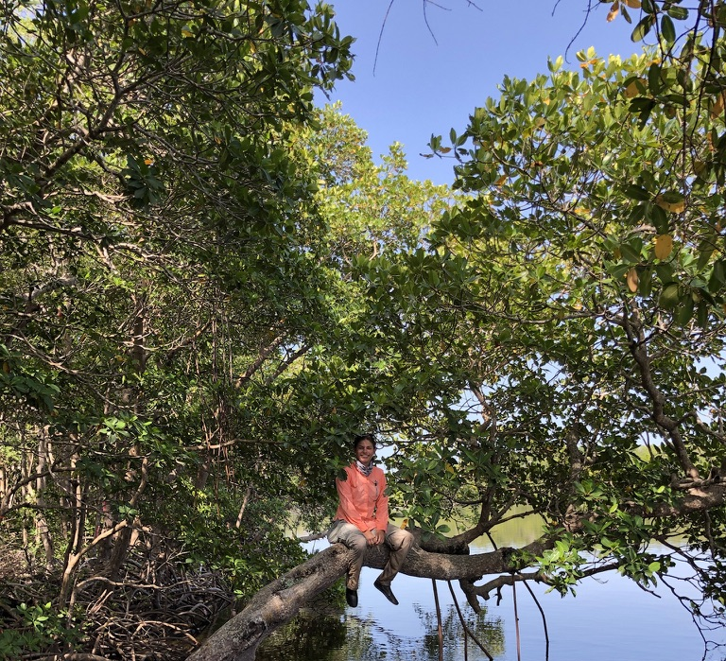
Together we can bring back ecological function to Florida’s coastline
Thank you for your time!

